Slide 1
Smarter Stock, Fewer Surprises
A Demand Forecasting and Inventory Tool Built for Your Business
Prepared for Mr Joseph, [SAMPLE CASE STUDY]
By Yusuf Abdullahi
19th August 2026.

Slide 2

The Balancing Act Every Distributor Knows
Order Too Little
Order Too Much
Lost sales and disappointed customers
Missed revenue opportunities
Money tied up in unsold stock
Storage costs and cash flow strain
This project builds a tool to help you get that balance right, using your own sales history.
Technical Note: Framing aligns with classic business problem, cost structure of overage vs. underage, addressed via data-driven demand signal.

Slide 3
What We Built For You
1
2
3
Forecasting Engine
Inventory Health System
Clear Recommendation
Predicts how much of each product will sell, for every product, every sales channel, and every region, on any given day.
Flags which products are running low, and which are sitting with too much stock, right now.
A single, evidence-based starting point so you know exactly where to focus your attention first.
Technical Note: Built entirely with Python, pandas, and scikit-learn. No deep learning or heavy frameworks, by design, this is a lean, maintainable MVP.

Slide 4

About the Data Behind This Project
This system was built and tested using close to three years of daily sales history. Before relying on it, we checked the data carefully to confirm it behaves like real sales activity.
190,757
30
Sales Records Analyzed
Products Tracked
3 yrs
3×3
Daily History
Regions & Channels
2022 to 2024
Across your full distribution network
Technical Note: Dataset is synthetic, generated to reflect realistic demand patterns. Verified for genuine trend, promotion effects, and stockout mechanics prior to adoption.

Slide 5


Every Sale, Tracked in Detail
For every single day, we know exactly what sold, where, and how.
Product
Sales Channel
Region
Units Sold
This granular detail is what allows the forecasting engine to learn the true patterns in your business.
Technical Note: Grain confirmed unique at date + SKU + channel + region. Category, brand, and segment fixed per SKU; pack type varies as expected.

Slide 6
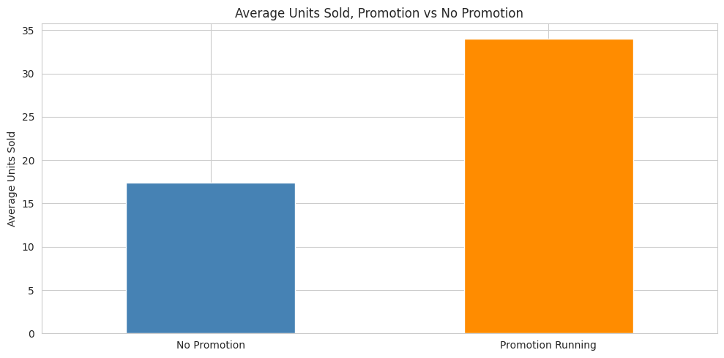
What Actually Drives Sales
Promotions Nearly Double Daily Sales
On days with an active promotion, average sales jump from about 17 units to about 34 units. This happens on roughly 1 in every 7 days.
Understanding this pattern means the system can anticipate demand spikes before they happen, so you can prepare stock in advance rather than scrambling to catch up.
A single promotional day moves as much stock as two normal trading days. The forecasting engine accounts for this every time it makes a prediction.
[Source: Notebook Part 2, Section 2.4]

Slide 7
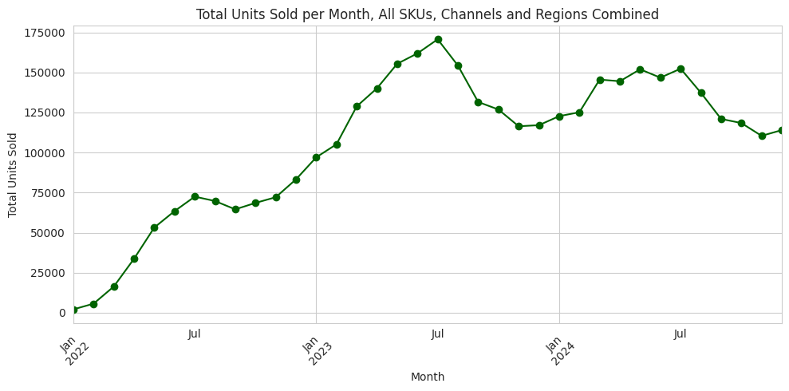
Your Business Has Grown, and Settled Into a Strong Rhythm
Sales started small in early 2022 and climbed steadily, peaking around mid-2023. Since then, monthly sales have leveled off at a level several times higher than where the business started, a sign of a maturing, stable operation.
Source: Notebook Part 2, Section 2.3 — Monthly units sold over time, showing growth phase and plateau]
Early 2022
Mid-2023 Peak
2023–2024 Plateau
Low baseline, business ramping up
Highest recorded monthly volume
Stable, mature demand — ideal for forecasting

Slide 8
We Checked Our Own Work — and Found a Problem Worth Fixing
1
Found It
2
Investigated It
3
Fixed It
While building the forecasting features, we noticed some calendar days were missing from the sales records, for every single product line,.
We confirmed this affected all 270 product, channel, and region combinations, averaging about 15% of days missing per line.
We rebuilt our forecasting features to correctly account for these gaps, so the model is never learning from mistaken assumptions about what happened on a missing day.
A forecasting tool is only as trustworthy as the process that built it.
Technical Note: Root cause: staggered SKU launch dates plus genuine gaps. Fixed via per-series calendar reindexing before computing lag and rolling features; rolling window relaxed to min_periods=3.

Slide 9





How the Forecast Actually Works
Four stages turn your raw sales history into a reliable daily prediction.
Start Simple
Add Real Patterns
We first tried the most basic guess possible, assuming tomorrow looks like yesterday.
We taught the model to recognize which factors actually matter, like current stock and active promotions.
Test Rigorously
Choose the Best
We tested every version against real, unseen data the model had never been shown before.
We kept the version that performed best and was least likely to fail on new data.
Technical Note: Final model: Random Forest Regressor (max_depth=10, min_samples_leaf=5), selected over Linear Regression and Gradient Boosting after time-based train/test evaluation. Hyperparameters tuned to balance bias-variance tradeoff and prevent overfitting.

Slide 10
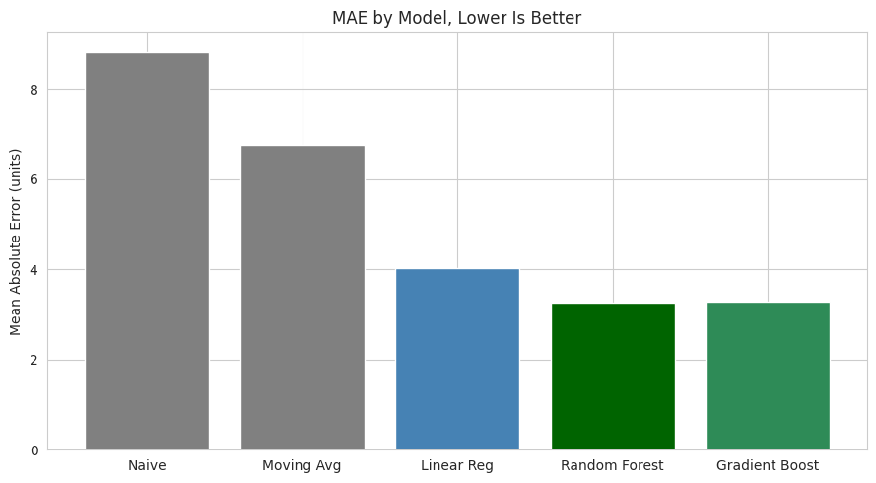

How Accurate Is This Forecast, Really?
~60%
More Accurate Than Guessing
Compared to simply assuming tomorrow will look like yesterday, this system typically cuts forecasting error by roughly 60 percent, across every way we measured accuracy.
That means fewer emergency orders, fewer overstock situations, and more confident purchasing decisions every week.
Metric
Baseline
Source: Notebook Part 5, Section 5.4 , Baseline vs. Model accuracy comparison across all metrics]
Technical Note: MAE improved from 8.83 → 3.26 units (63.0% reduction). RMSE improved 62.6%. MAPE improved 61.9%. Evaluated on temporally held-out test set to prevent data leakage. All metrics computed on unseen Nov–Dec 2024 period.

Slide 11
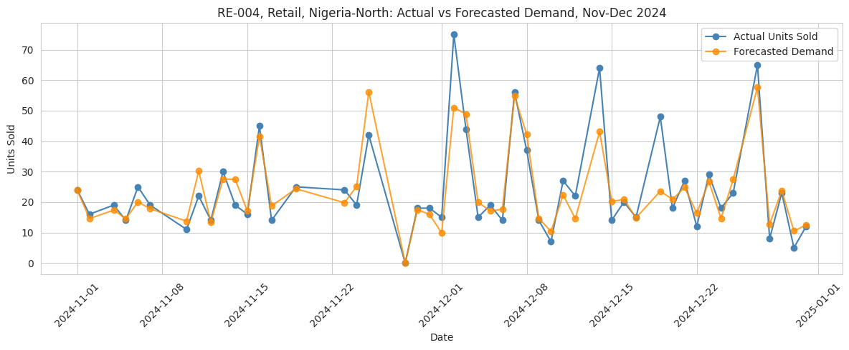

A Real Example, One Product Line
Here is what this looks like for one of your actual products over a two-month period. The orange line is what we predicted in advance, the blue line is what actually happened.
Source: Notebook Part 5, Section 5.2. ( Retail channel, Nigeria-North region.)
Even the dip to zero sales on one day was predicted correctly, because the model knew that specific product was completely out of stock that day.
Technical Note: Example series: SKU RE-004, Retail channel, Nigeria-North region. Largest observed forecast errors occurred on promotion days with unusually large uplift, and one unexplained non-promotional demand spike, both disclosed honestly in the underlying analysis.

Slide 12
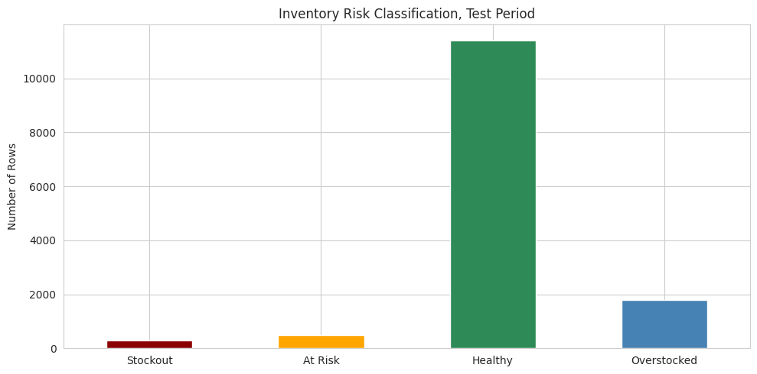

Turning Predictions Into Daily Decisions
For every product, in every channel and region, we compare current stock against expected demand and sort it into one of four simple categories, so you always know where to look first.
✅ Healthy
📦 Overstocked
Stock levels are well-matched to expected demand. No action needed.
More than 12 days of cover. Capital is tied up unnecessarily.
⚠️ At Risk
🚨 Stockout
Fewer than 5 days of cover. A stockout is approaching.
No stock available. Sales are being lost right now.
Days of cover = stock_available ÷ forecasted demand. At-risk threshold: under 5 days (maximum observed delivery lead time). Overstocked threshold: over 12 days (roughly double that lead time). Test period split: 81.8% Healthy · 12.7% Overstocked · 3.5% At Risk · 2.0% Stockout.
Source: Notebook Part 4, Section 4.8 (stock status distribution chart.)

Slide 13
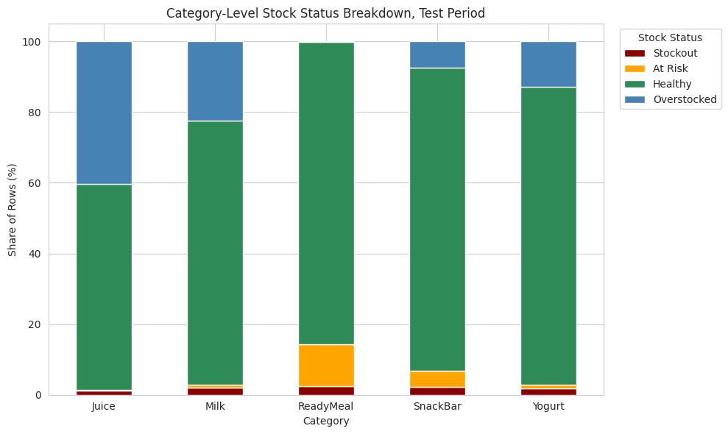

The One Finding That Matters Most
Ready Meals (Running Out Too Often)
This product line runs out of stock far more often than any other, more than three times the rate of the next closest category.
Flagged At Risk in 11.85% of test rows, versus 4.62% for the next-highest category. This is where sales are being lost.
Juice (Too Much Stock Sitting Idle)
This line is significantly overstocked, tying up money that could be working elsewhere in the business.
Flagged Overstocked in 40.26% of test rows. Channel and region showed no meaningful variation; the actionable signal is concentrated entirely at the category level.
Source: Notebook Part 5, Section 5.6 (category-level stock status breakdown)

Slide 14
Being Upfront About What This Tool Can and Cannot Do Yet
Every honest tool comes with a clear account of its limits. Here is ours.
✅ Accurate day-to-day forecasting
⚠️ Cannot yet warn several days ahead
Demand is modelled at the product, channel, and region level with strong real-world accuracy, including known stock-out days.
Early-warning stockout alerts are a natural next development but are not part of this MVP version.
✅ A clear, real-time picture of stock health
⚠️ Cannot account for unusually large promotions
Every SKU is automatically classified into one of four actionable categories, no manual guesswork required.
The model handles typical promotions well, but extreme uplift events can still exceed its predictions.
✅ A specific, evidence-backed place to focus first
⚠️ Requires retesting on new business data
Ready Meals and Juice are identified with data, not instinct, as your highest-priority lines to act on.
These exact numbers reflect the test dataset. Performance on a different real business should always be validated before relying on the figures.

Slide 15

What This Could Mean for Your Business
The Investment So Far
The Potential Impact
This MVP was built as a lean, focused first version with minimal development cost
Recover missed Ready Meal sales
Reducing stockouts on your Ready Meal line could recover an estimated $2,239 in currently missed revenue.
Recommended Next Step
Pilot this system on your Ready Meal and Juice lines first, that is where the evidence points to the clearest, fastest win. Then expand to the full catalogue once validated against your real numbers.
Free up Juice working capital
Trimming excess Juice inventory could release approximately $128 back into the business.
~60% improvement in forecast accuracy
Note for Mr Joseph: The bracketed figures below are placeholders. Do not substitute estimated or fabricated numbers, leave them as-is until your real figures are supplied.
Fewer emergency reorders, less guesswork, and smarter purchasing decisions across your entire catalogue.

